Slide 1
FAKE NEWS PREDICTION PROJECT
Submitted by:
P. Sai Deekshith Reddy

Slide 2
Problem Statement
-Context
Fake news has become one of the biggest problems of our age. It has serious impact on our online as well as offline discourse. One can even go as far as saying that, to date, fake news poses a clear and present danger to western democracy and stability of the society.
-Content
What's inside is more than just rows and columns. Make it easy for others to get started by describing how you acquired the data and what time period it represents, too.
What is a Fake News?
Fake news's simple meaning is to incorporate information that leads people to the wrong path. Nowadays fake news spreading like water and people share this information without verifying it. This is often done to further or impose certain ideas and is often achieved with political agendas.
For media outlets, the ability to attract viewers to their websites is necessary to generate online advertising revenue. So it is necessary to detect fake news.

Slide 3
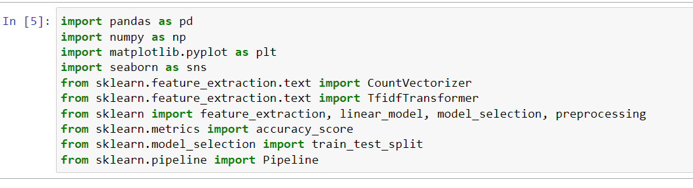
Using library for detection

Slide 4
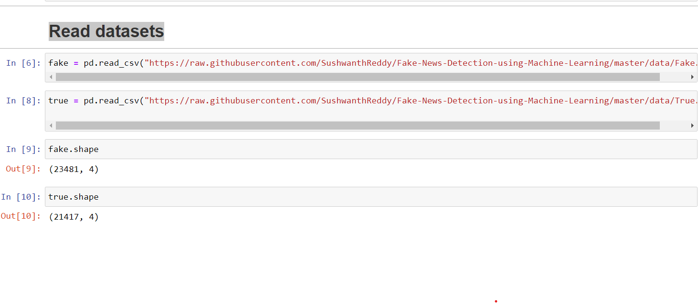
Read datasets & Analysis

Slide 5
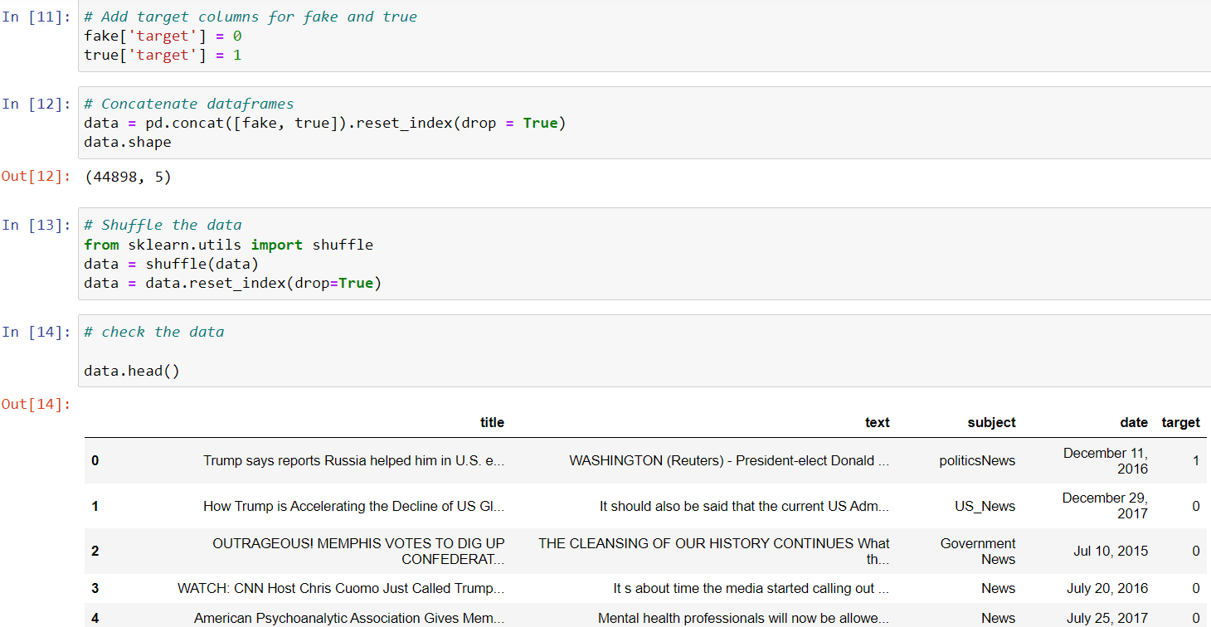
Data cleaning and preparation¶

Slide 6
Removing the date (we are not using it for the analysis)
Checking Null values
Removing the title (we will only use the text)
Remove punctuation
Removing stopwords

Slide 7
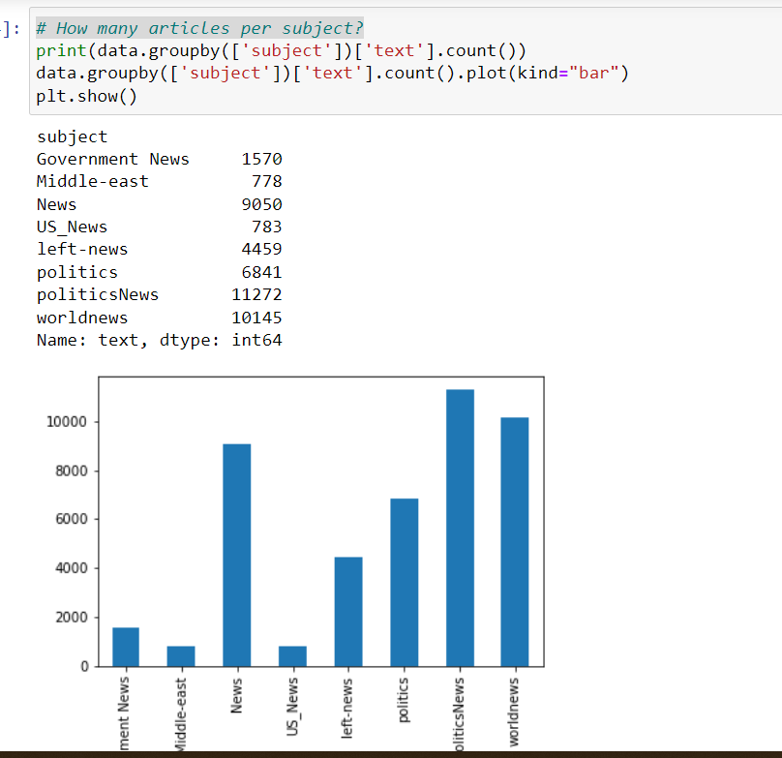
EDA Process
We are using count plot for # How many articles per subject?

Slide 8
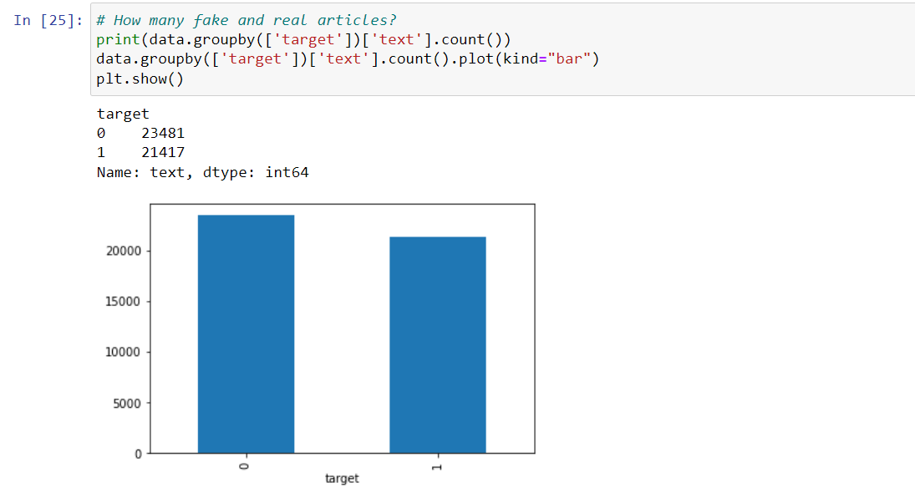

Slide 9
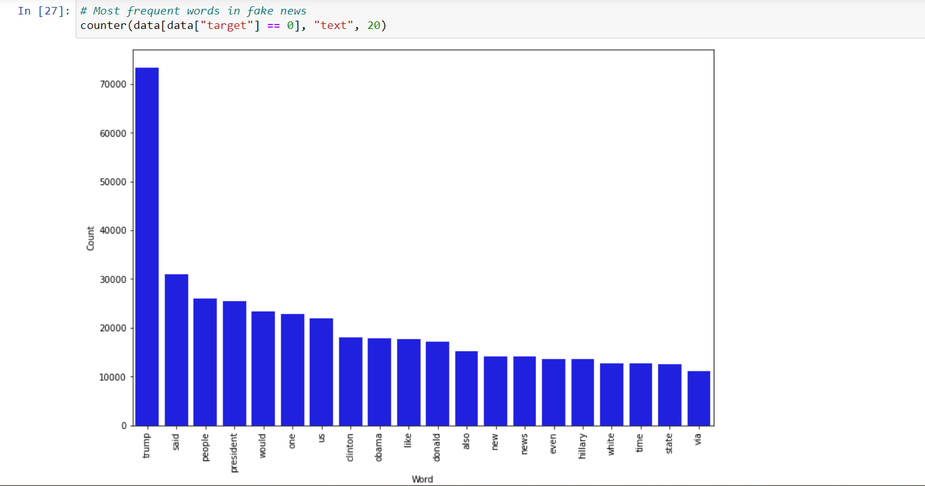

Slide 10
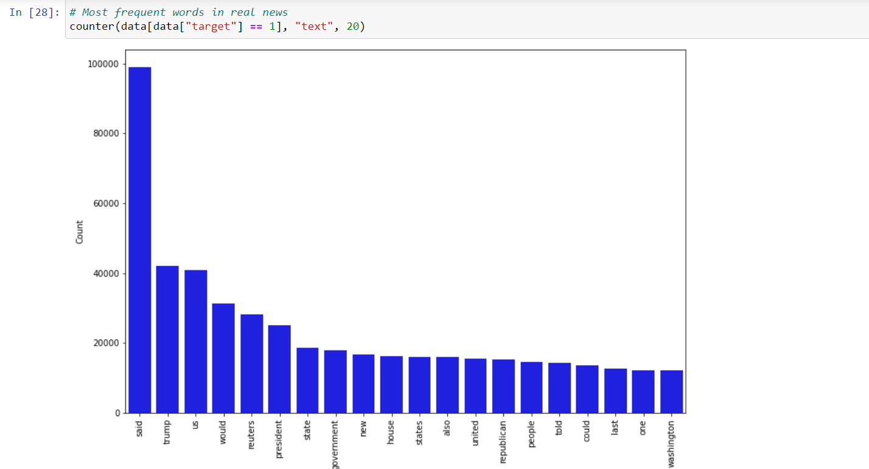

Slide 11
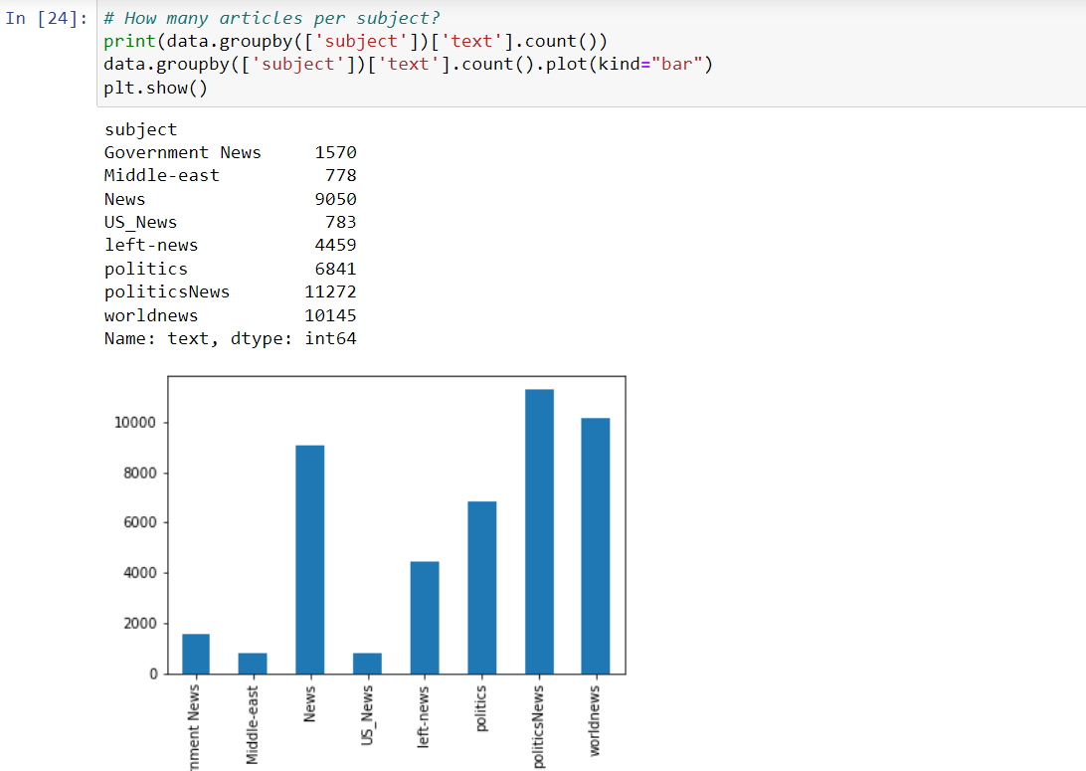

Slide 12
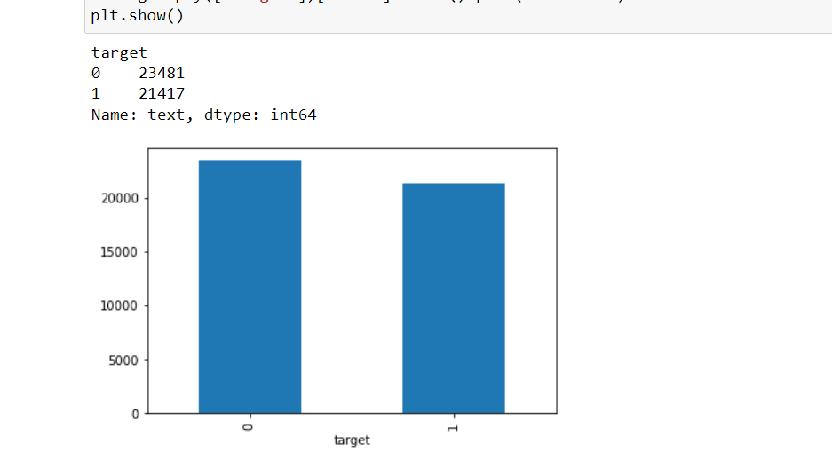

Slide 13
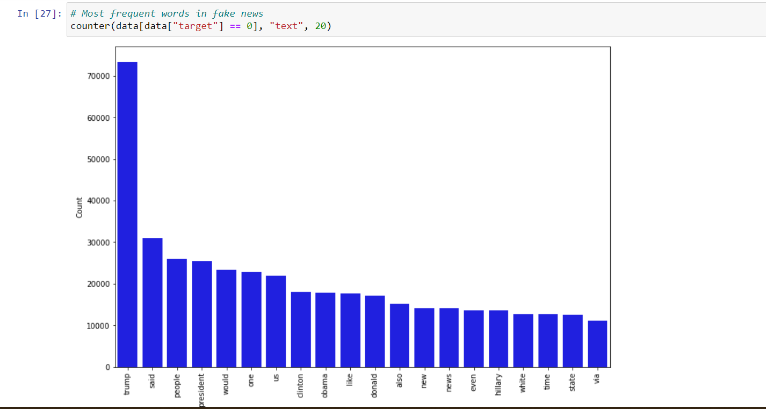

Slide 14
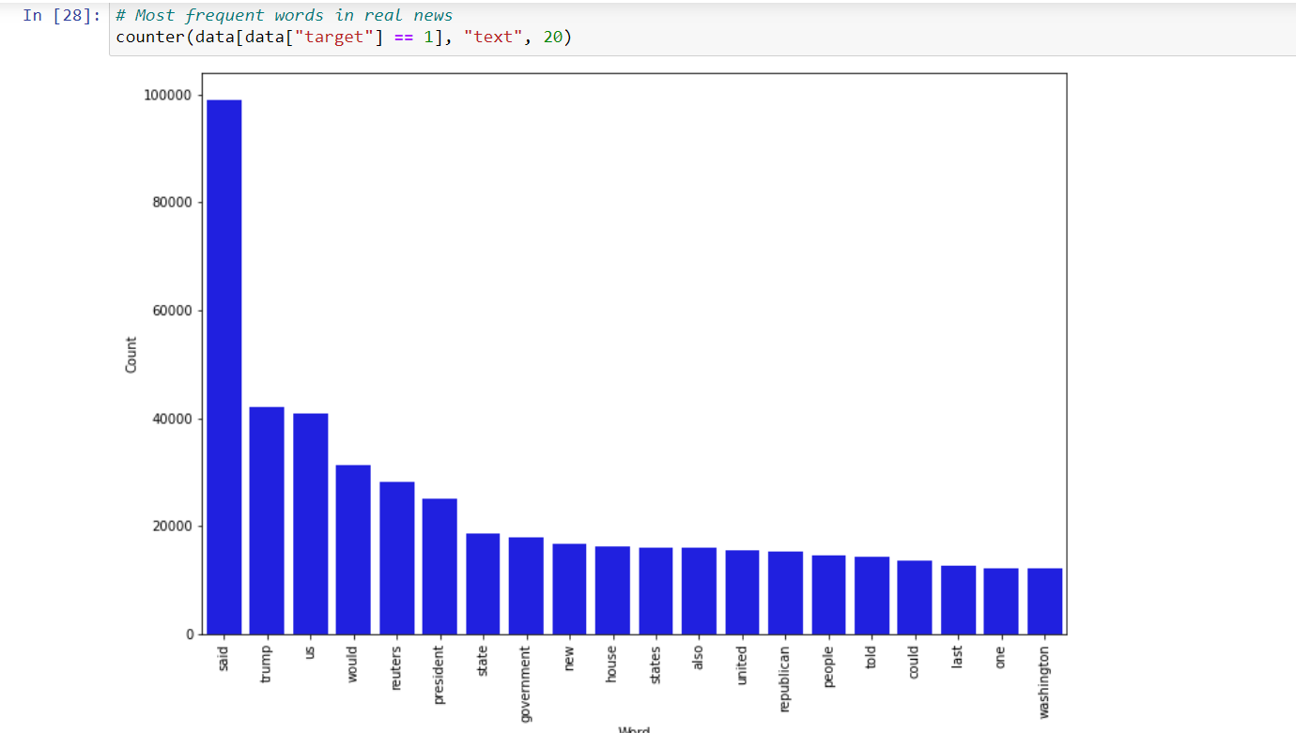

Slide 15
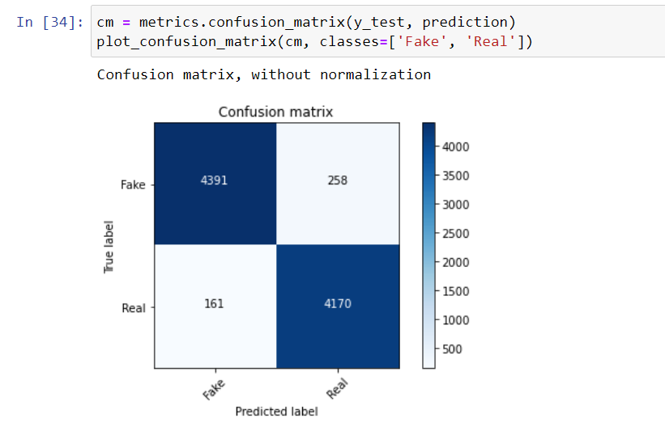
Model building
accuracy: 95.33%
# Split the data
X_train,X_test,y_train,y_test = train_test_split(data['text'], data.target, test_size=0.2, random_state=42)
Using model
Naïve bayes – accuracy :95.33%

Slide 16
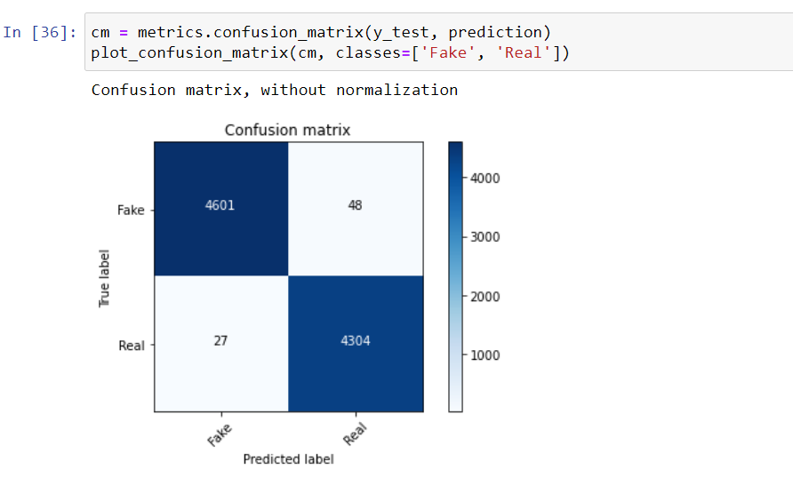
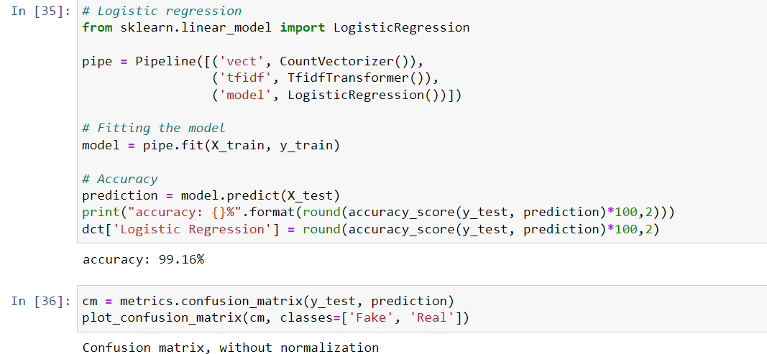
Logistic regression
Confusion Matrix

Slide 17
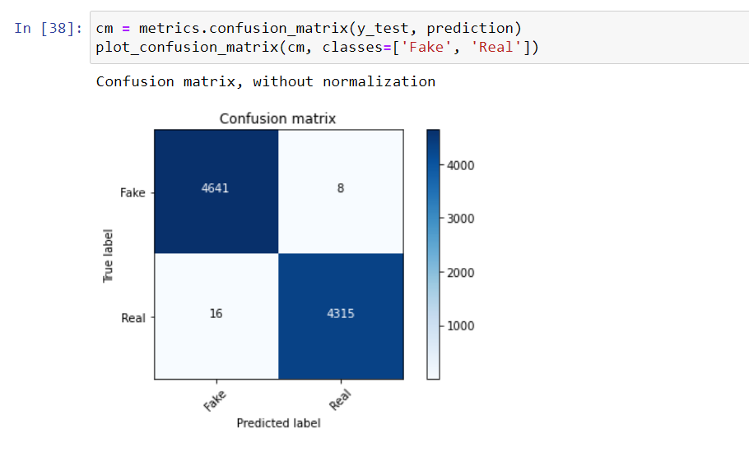
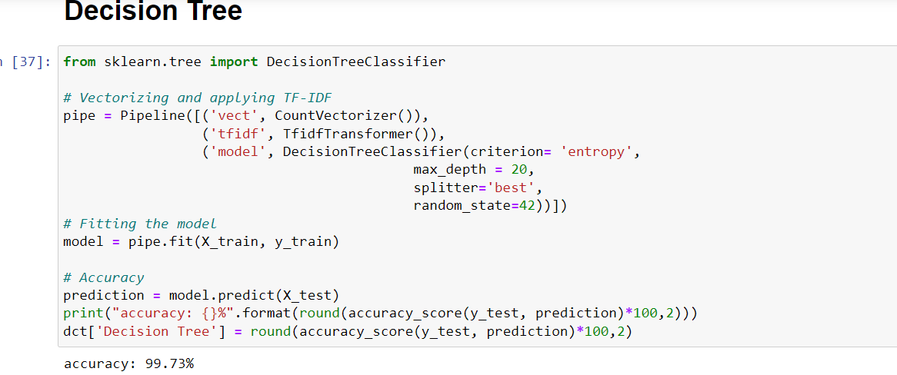
DecisionTreeClassifier

Slide 18
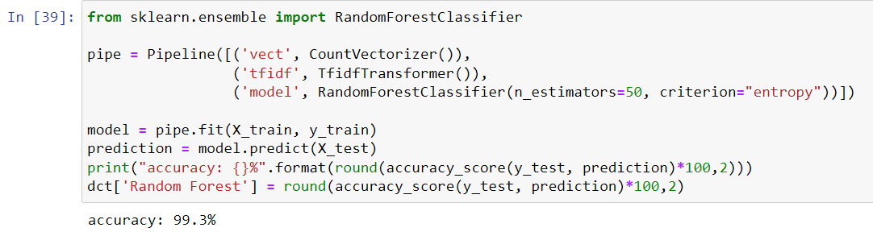
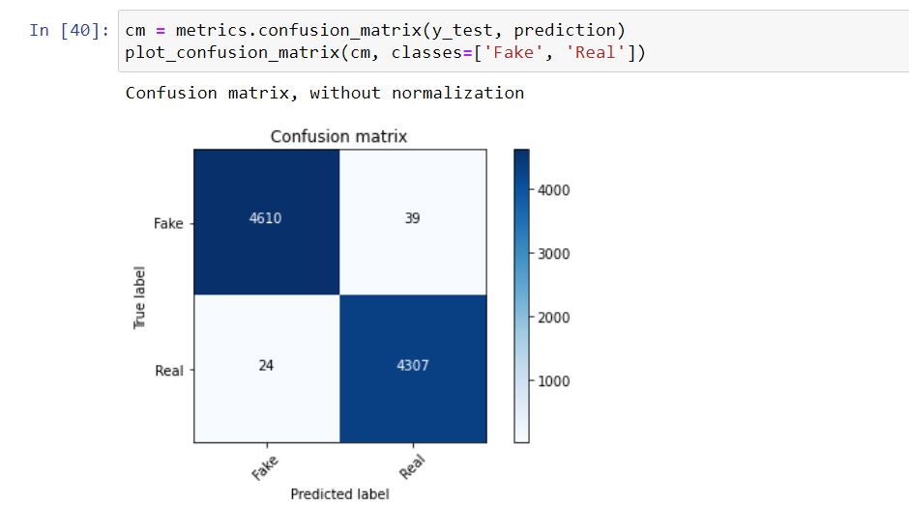
Random Forest Classification

Slide 19
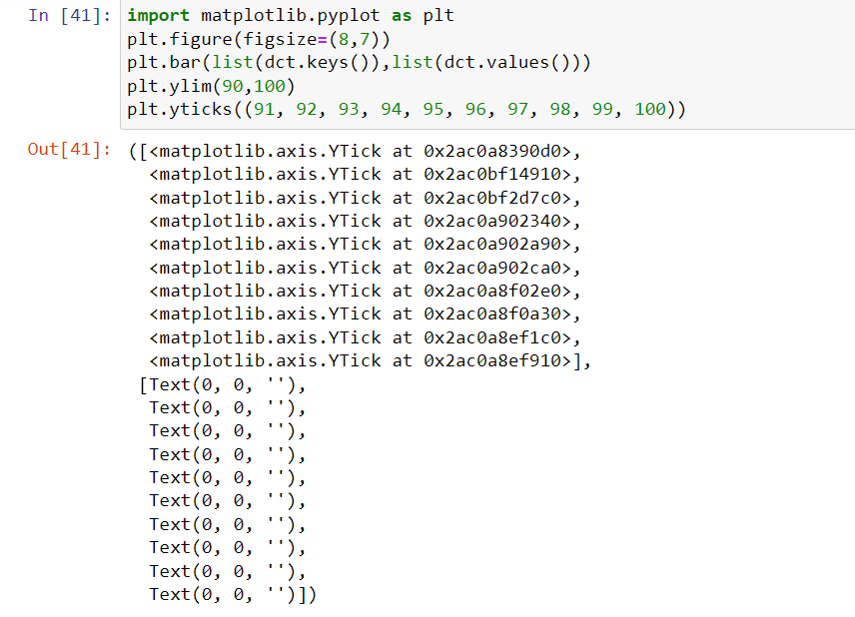
Comparing Different Models

Slide 20
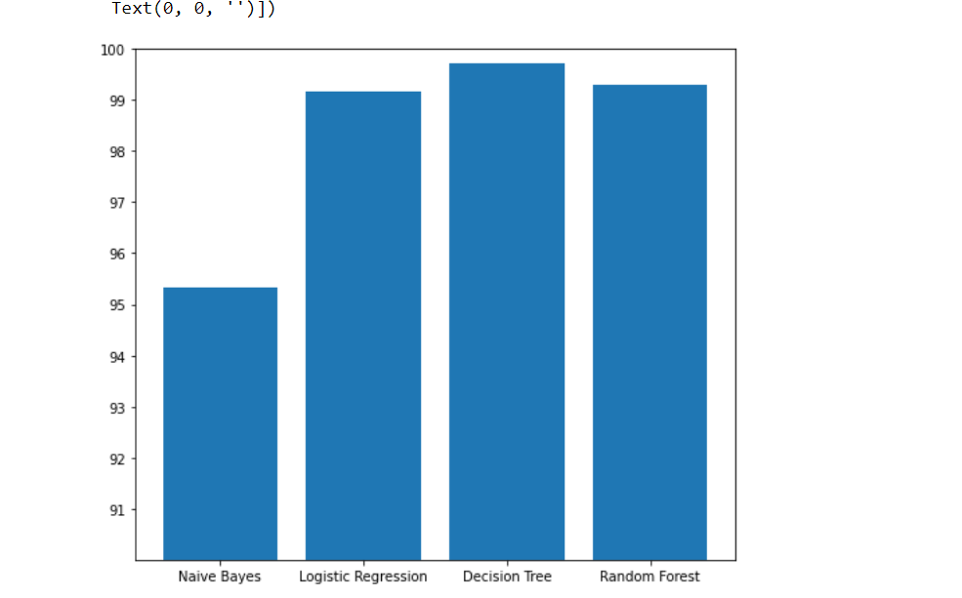
Plot
We can clearly observe that Decision Tree is giving high accuracy

Slide 21
Conclusion
We have applied many algorithm like (Naive Bayes , Logistic Regression,Decision Tree ,Random Forest ). but as we can see that Decision Tree has given the best accuracy score.
And we have selected DecisionTree as our best model because it is giving high accuracy compared to other models

